Slide 1

Three Income Levels
Slides by B. Ricks PhD
Computer Science
University of Nebraska at Omaha
© 2020

Slide 2


Three Income Levels
Less than you need | More than you need | Everything you want

Slide 3
Three Levels in Detail
Less than you need | More than you need | Everything you want
Life is hard. Can’t provide food for those you love. Not even thinking about wants. | Life is good. You can provide for those you love. You still have wants. | Life is AMAZING! You can buy anything you want. You have no wants.

Slide 4
Why should you care?
Less than you need | More than you need | Everything you want
Changing from one category to the other is often worth sacrifice (e.g., time to get an education).
Shifting within a category may not worth the sacrifice.

Slide 5
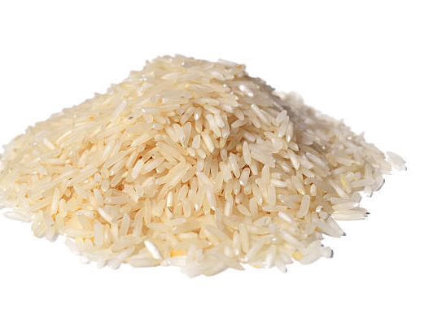
Less Than You Need
International Poverty Lines
Amount/ Day | Amount/ Year | World Population
<$1.90 | <$700 | 9.5%
< $3.20 | <$1,200 | ~15%
< $5.50 | ~$2,000 | ~25%
https://openknowledge.worldbank.org/bitstream/handle/10986/34496/9781464816024.pdf

Slide 6
More Than You Need
If you make more than $32K/year, you are in the top 1% of earners in the world.
What do you really want in life?

Slide 7
More Than You Want
Can you really have more than you want?

Slide 8
Three income levels?
Less than you need | More than you need | More than you want
Does not exist.

Slide 9
Why should you care?
Less than you need | More than you need | Doesn’t Exist
No debt, career, sacrifice, or gamble will give you everything you want.
Any person, employer, or ad that implies otherwise is lying.

Slide 10
The Real Income Levels
Less than you need | More than you need
 | Contented | Unhappy

Slide 11
Why should you care?
Less than you need | More than you need
 | Contented | Unhappy
One of life’s joys is helping someone move out of poverty.

Slide 12
The real difficulty
Less than you need | More than you need
 | Contented | Unhappy
One of life’s challenges is being contented and staying there.

Slide 13
Three Income Levels

